Slide 1
Crime Project
L.O. To be able to apply a number of different explanations as to why people turn to crime.
To understand these explanations through real criminals
To be able to research a criminal of your choice and create a fact file about them

Slide 2
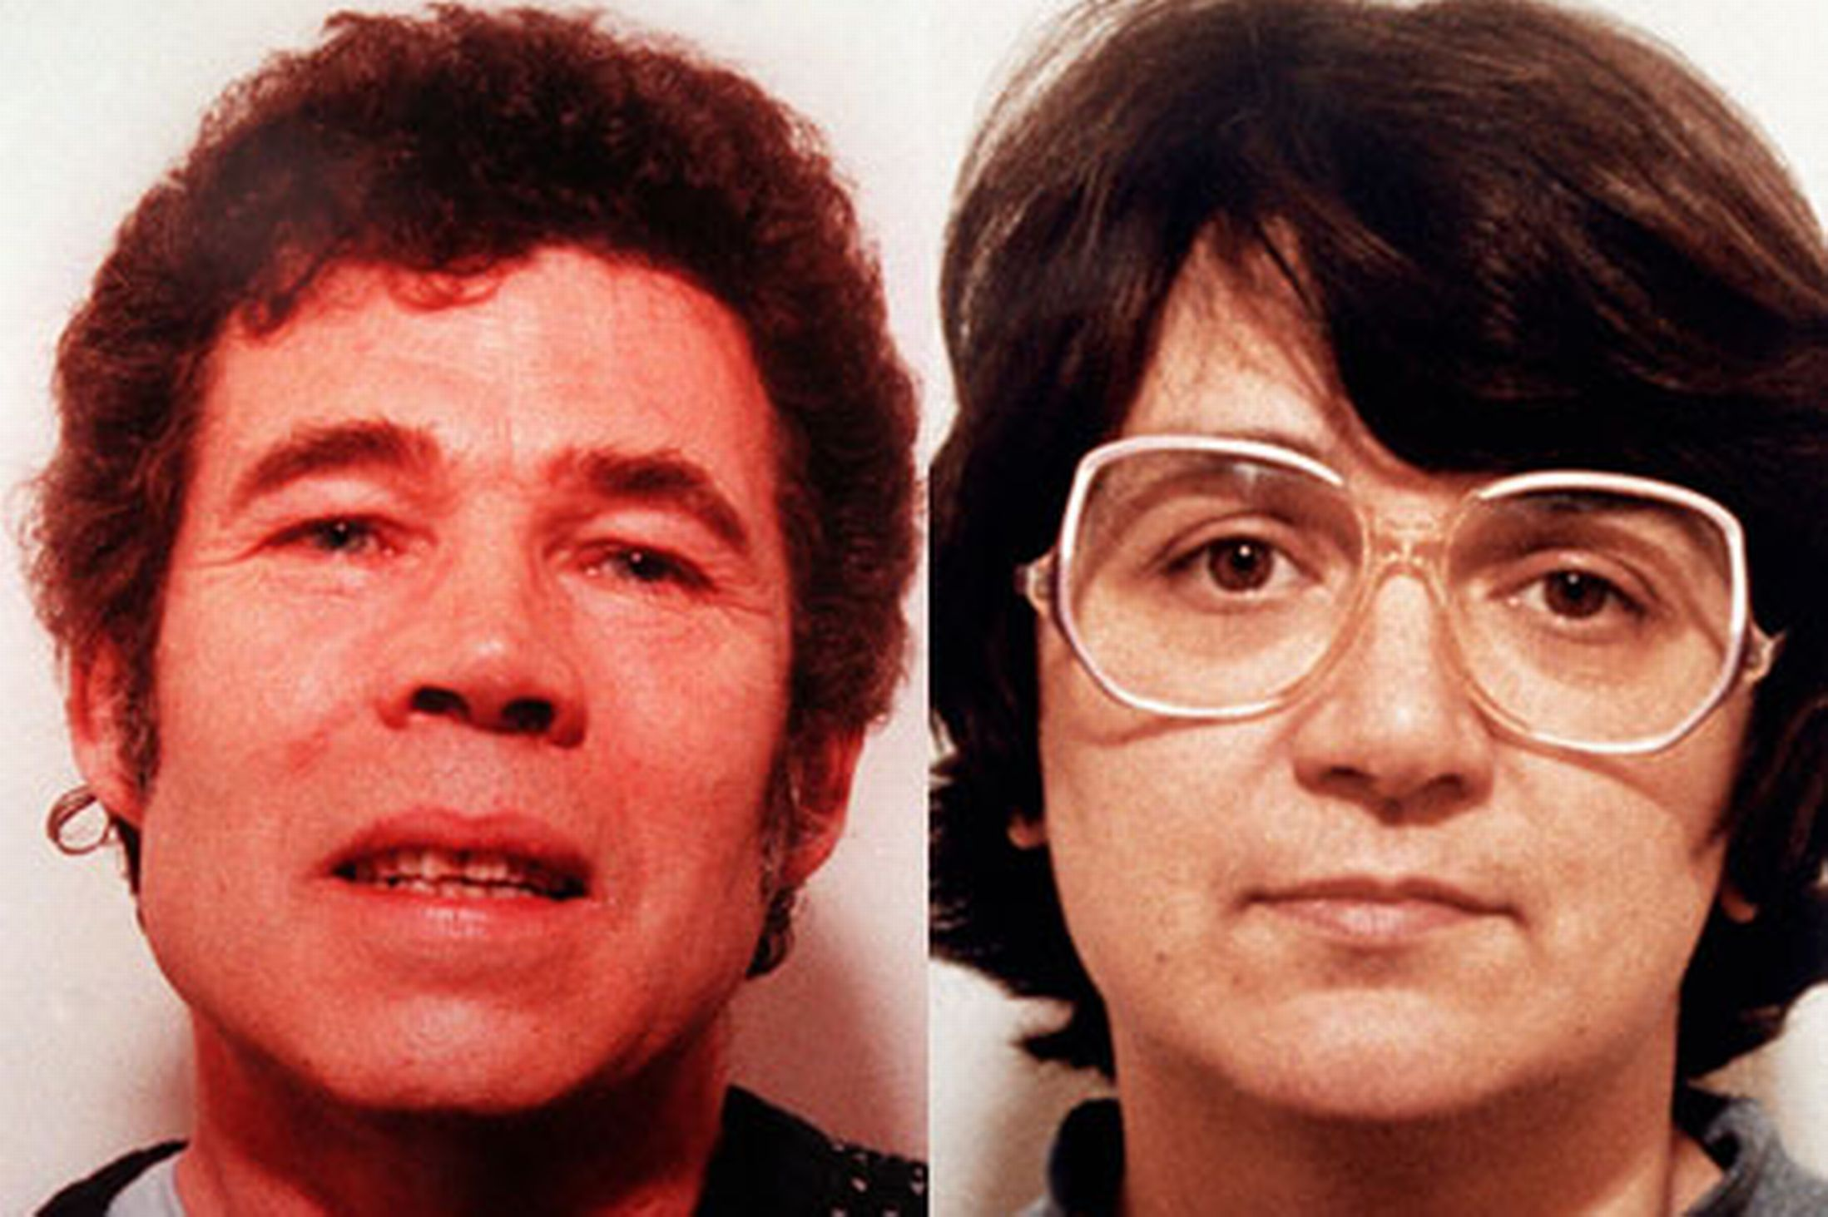
Fred and Rose West
Crime - murder (11-13 victims) many with sexual abuse
Biological reasons - Rose’s mentally ill mother, Daisy, suffered a severe breakdown in 1953, and underwent gruelling electric shock treatment – while pregnant with Rose.
Social reasons - her father, a paranoid schizophrenic, was prone to violence and repeatedly sexually abused her….. By the age of 13, Rose was sexually abusing her two younger brothers too.
Individual reasons - Rose and Fred were narcissistic, psychopathic and had antisocial personality traits.
Fred didn’t do well at school, he dropped out and became a simple farm laborer. He had a low IQ of 84. Low intelligence, a dysfunctional upbringing and suffering from two major head injuries must have had an impact on the choices he made later in his life.

Slide 3
Project
Find an example from the media (past or present) of someone who has committed a crime and been found guilty of it.
Create a fact file about their background, the crime they committed and the consequences, and what sentence they were given.
Give psychological reasons as to why they have committed the crime. Biological, social and individual, each explanation needs to be supported with at least one piece of research
Write a conclusion stating which explanation you believe to be the most valid and why. Your conclusion could also include a suggestion on what needs to be done to stop future crimes like this.
Make a suggestion about what, if any, methods of modifying behaviour the perpetrator could/should be given to prevent re offending (treatment).

Slide 4
How to present your info...
https://www.youtube.com/watch?v=S646XSz09_U
https://www.youtube.com/watch?v=knv6wPfMsVk
An article for Psychology Review
A prison cell of person’s life on the walls
Investigators diary log
A court case
Interview between police and offender
A therapy session between psychologist and offender
A poster
A model/ artefact
Anything you want, get creative!
Requirements
Individual task: Fact file and artefact: see possible list to the left
Show and tell/presentations will be first lesson back in year 12

Slide 5

Part 1
After 1 hour you should have
Chosen your ‘criminal’
Background research on crime(s) committed
Background research into the person including upbringing, family, medical history etc. This should be categorised into Biological, Cognitive, Behavioural etc (whichever are relevant)

Slide 6
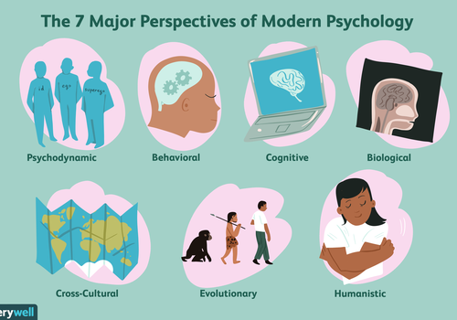
Part 2
Today you need to back up/find evidence to support the social/individual/biological explanations.
This could be in the form of psychological studies, articles, case studies, medical research, psychological theories etc.
Extension - you could begin to evaluate the research.

Slide 7
Part 3
Recap research so far and write your conclusion
Begin to research treatment options and make a suggestion which is most appropriate and why.
Extension - evaluate the treatment you have chosen with psychological evidence to demonstrate effectiveness.

Slide 8
Part 4
Creation of artefact!
Which of the suggested methods have you chosen to create?
Use this time to put together your model/ presentation/ journal as a creative way to get information across

Slide 9
Part 5
Make sure you have met all of the requirements
Present the information in whichever format you choose.
Prizes will be awarded for
Meeting the criteria set
Creativity of presentation
Effort (across lessons during transition and at home)

Slide 10
Project Brief
Peer Marking
/10 For meeting requirements on left (2 per bullet point)
/10 For quality of information
/10 For amount of research (psychological/biological/sociological etc.) provided
/10 For creativity and presentation of project
/10 For effort involved
Find an example from the media (past or present) of someone who has committed a crime and been found guilty of it.
Create a fact file about their background, the crime they committed and the consequences, and what sentence they were given.
Give psychological reasons as to why they have committed the crime. Biological, social and individual, each explanation needs to be supported with at least one piece of research
Write a conclusion stating which explanation you believe to be the most valid and why. Your conclusion could also include a suggestion on what needs to be done to stop future crimes like this.
Make a suggestion about what, if any, method of modifying the behaviour the offender could/should be given to prevent re offending.

