Slide 1

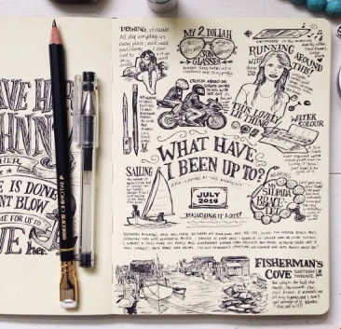
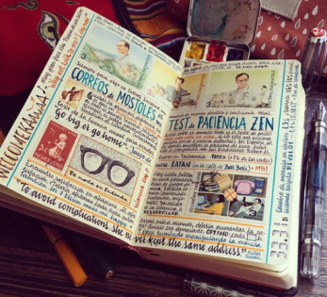
What?
Create a visual art journal which reflects aspects of your own life and personality in a small A4 sketchbook or altered book.
How?
Use a combination of drawings, paintings and text/words to illustrate the suggested themes using a range of materials, techniques and processes.
Why?
To develop and refine your observation drawing skills by looking more closely at things around you that you see every day, and to explore skills in creating drawings from imagination.
Y12 A level Art
Journal Transition Project
2023

Slide 2

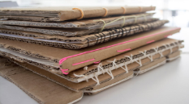
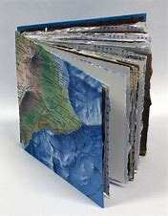
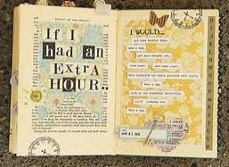
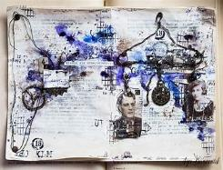



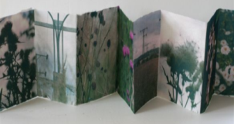
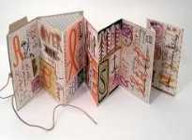
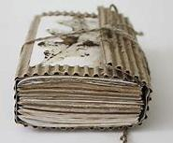


Sketchbook and Journal ideas
To begin with you will need a sketchbook, try to use one that is no bigger than A4 in size. It’s also just as easy to make your own - look at some of these examples for ideas.
You can use an old, damaged or unwanted paper or hardback book and draw on top of the pages and words
Cardboard cover folded in half with a range of papers inside. Bound together by wrapping some string or an elastic band around the middle.
Create an accordion or concertina journal by folding and gluing paper into a long strip.
https://www.accessart.org.uk/sketchbooks-an-online-course-for-children-families-parents-teachers/?fbclid=IwAR0eXgOhXUnmJdtsLP-0-SaSrYINphDO0pQP2KlcHuOGrEHLQMQpDJc2IYk

Slide 3
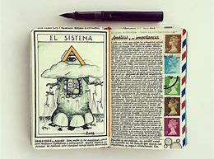
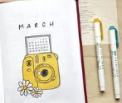
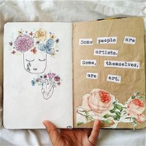
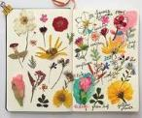
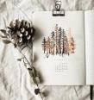
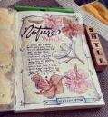
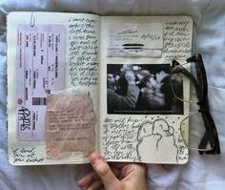
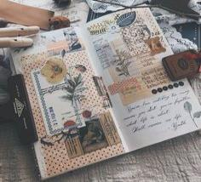
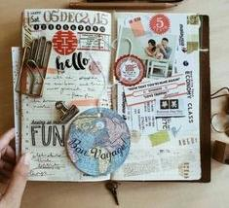
What will I draw?
You can also collage things into your journal and draw on top of them
Each double page will have a theme (coming up in later slides). You can draw from direct observation, use your own photos or find images on the internet as inspiration. Look at the slides below with artists who use sketchbooks and journals.
You can add more pages and continue it over the Summer too, ready to bring back in September.
Receipts
Tickets
Wrappers
Scrap paper
Envelopes
Postcards
Flyers
Newspapers

Slide 4
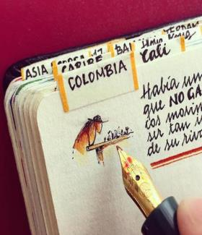
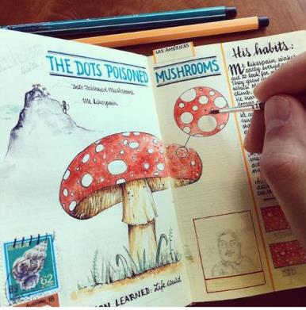



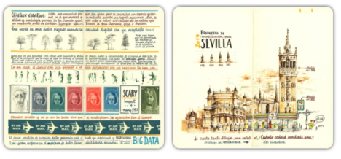
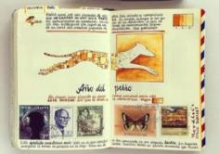


Page inspiration and layout ideas
You can use small titles using a relevant font as a way to give context to your page
Use annotation to write notes or add further information about the things you have drawn
Use more than one media or technique per double page. Try using different techniques, such as cross hatching, continuous line, detailed tonal studies etc
You can write down the location, date and the time that you do your page entry.
Think about literacy when you annotate your pages, and use these to create a flow and visual story which travels across different pages.
Use a range of different size drawings on the page and add small images and boxes
Think carefully about layout and composition.Some pages can be filled with images and others can have lots of empty space.

Slide 5
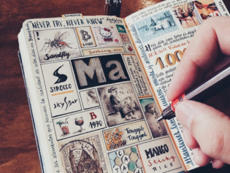
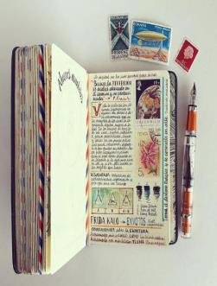
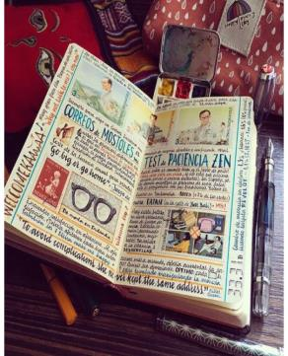
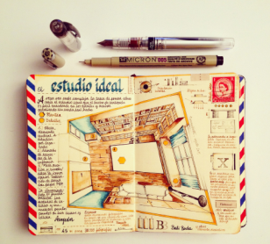
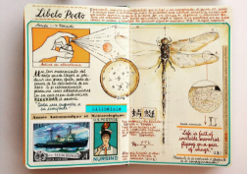
Jose Naranja
Jose Naranja turns ordinary notebooks into highly detailed works of art. The artist uses watercolours, stamps, writing, elements of photography and drawings to turn each notebook into a one of a kind masterpiece.
Naranja worked as an aeronautical engineer for many years but eventually decided to quit and devote his life to art and travels. The artist developed his passion for notebook art in 2005 when he discovered Moleskine pocket journals. As hard as it may be to believe, Jose is a self-taught artist, but his skills are remarkable. So far the artist has filled in 12 notebooks and recently has begun binding his own, to make his art even more personal.
http://josenaranja.blogspot.com/
https://www.thisiscolossal.com/2018/04/handmade-sketchbooks-by-jose-naranja/

Slide 6

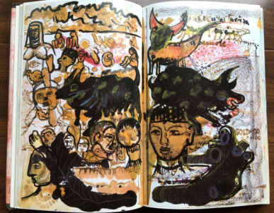
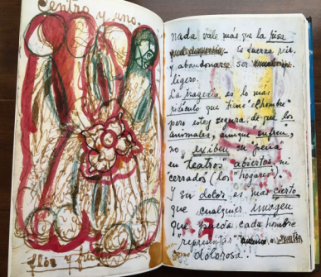
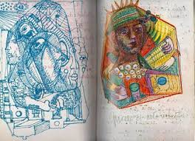
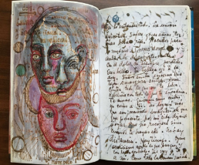
Frida Kahlo
Frida Kahlo's life was expressed through her work. A chronological look at her artwork provides an understanding of the events that changed her life: her passions, motivations, disappointments, and desires. Painting was cathartic for her, however, writing and keeping a diary also helped her to establish a relationship with herself, and to find a way of expressing her afflictions during the final 10 years of her life.
Kahlo found that writing, as well as painting, was useful not just for communicating with her family and friends—and also as a way of connecting with her own feelings, conveying her ideas on her artistic practice, and expressing her worries and pains, both physical and emotional.

Slide 7
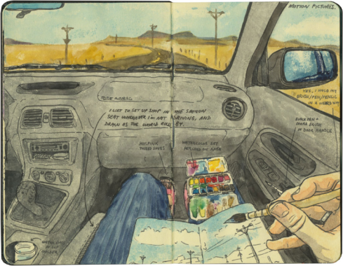
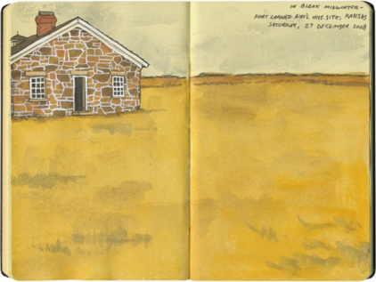
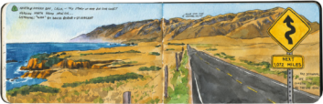
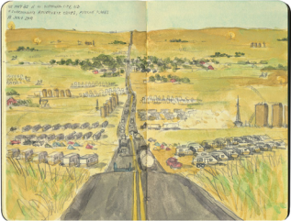
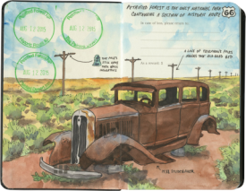
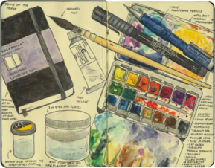
Chandler O’Leary

Slide 8
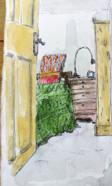
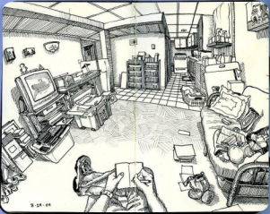
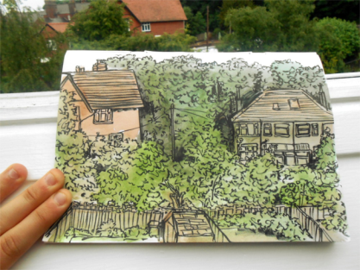
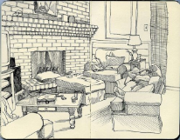
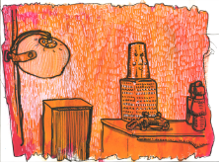
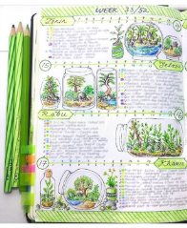
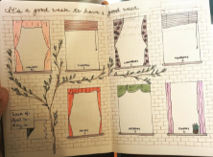
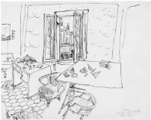
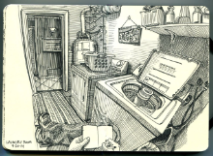
On the following slides there are some themes for you to choose for your journal pages.
Inside.
Outside.

Slide 9
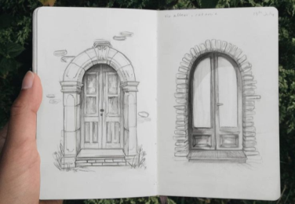
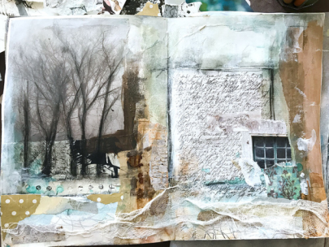
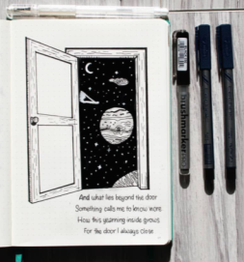
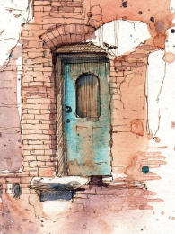


Doors
Windows

Slide 10











Trees
Water

Slide 11








Possessions/still life

Slide 12








Colour
Nature

Slide 13







The Weather
Texture/surfaces

