Slide 1
BTEC Level 3 in Business
Unit 1: Exploring Business

Slide 2
Learning Aim A
Explore the Features of Different Businesses and Analyse What Makes them Successful

Slide 3
Learning Aim A1
Features of Businesses

Slide 4
Features of Businesses
Every single business that exists has its own set of unique features which could also be referred to as characteristics.
The core features of any business typically encompass:
The ownership and liability of the business.
The purpose of the business.
The sector the business operates within.
The scope of business activities.
The size of the business.

Slide 5
Features of Businesses
Activity 1: Features of Businesses.
Before we investigate each one of these business features in more detail, select two contrasting businesses of your choice and place them in the table located in your workbook.
We will revisit the remainder of this activity once we have discussed each feature.
When we revisit this activity, you will apply each feature discussed to your two chosen businesses and make comparisons between them both.
Ensure you take notes during the following slides and clearly explain the key differences in relation to the features of your chosen businesses when we revisit this activity.

Slide 6
Ownership and Liability:
Private
Public
Not-for-profit
There are three ways in which a business can be owned:

Slide 7
Ownership and Liability:
Before we take a look into each type of business ownership in greater detail, it’s important to understand the term ‘liability’ and its importance in business.
Dependent on the type of business ownership, the owners will either have limited or unlimited liability.
With limited liability, the liability of the owners for any losses, debt, or claims the business faces is limited to the amount of money they have invested into the business and their personal assets are not at risk.
Whereas, with unlimited liability, the owner of the business is personally responsible for any losses, debts, or claims that the business experiences and their personal assets such as a house or a car etc. are at risk should the business have insufficient funds to cover any of these liabilities.
To protect the business against the risk of being sued or being legally held responsible, business owners can purchase insurance in a similar fashion to a person purchasing car or home insurance which can provide cover for the business against damages and legal costs that may be made against the business.

Slide 8
Ownership and Liability:
First of all, let’s take a look at privately owned businesses.
Private businesses are owned by people with the aim of making a profit.
However, in exchange for this they are liable for all aspects of the business and are likely to take many risks.
Private businesses range in size from just one person to multiple partners across many different types of ownership which include:
Sole trader
Partnership
Private limited company
Public limited company
Cooperative

Slide 9
Ownership and Liability:
Activity 2: Ownership and Liability.
Watch the video on the various types of business ownership on the following slide and complete the tasks below in your activity workbook:
Sole Trader vs Partnership Starting a Business Scenario.
Becoming a Limited Company Scenario: Private vs Public.
Finding out about Franchises.
Extension task: types of business ownership wordsearch.

Slide 10
Ownership and Liability:
Video link: Types of Business Ownership
Notes:
Video link: https://www.youtube.com/watch?v=BN2cQNNvg_4&t=275s

Slide 11
Contrasting businesses
P1 - Explain the features of two contrasting businesses.
P2 - Explain how two contrasting businesses are influenced by stakeholders.
Non-profit vs For-profit

Slide 12
Contrasting businesses
Non-profit organisations that would be suitable and recommended for Unit 1:
Oxfam
UNICEF
WaterAid
MIND
Cancer Research UK
British Heart foundation
British Red Cross

Slide 13
Ownership and Liability: Private – Sole Trader
A sole trader is the most popular type of ownership and is often referred to as self employed or sole proprietor and describes any business that is owned and controlled by one person.
In 2020, 76% of businesses in the UK were registered as sole traders, which accounts for approximately 4.6million businesses (Startupdonut, 2020).
A business owner can still register as a sole trader even if they have employees and are often individuals who provide a specialist service like plumbers, hairdressers or photographers.
Easy to set up
Owner has complete freedom over business decisions
Low start up costs
Owner retains 100% of the profits
No separate business entity
Unlimited liability
Long working hours, which can be lonely and very pressurised
Additional responsibility i.e. admin, bookkeeping, and marketing
Notes:
https://www.startupdonut.co.uk/set-up-a-business/registering-as-a-sole-trader/13-things-you-should-know-about-being-a-sole-trader

Slide 14
Ownership and Liability: Private – Partnership
Partnerships are similar in nature to a sole trader but are legally owned by two or more people.
Typical examples of partnerships are skilled people and professionals who decide to set up a business together such as trades people, dentists, and solicitors.
A partnership agreement is a key legal document which is agreed and signed by all partners of the business and covers all the key legalities of the business such as how management decisions are made and how profits are shared.
There are also two other versions of business partnerships, these are limited partnerships and limited liability partnerships.
Shared expertise
Shared workload and responsibility
Low start up costs
Greater borrowing power
Potential for disagreements
Profits have to be shared
Unlimited liability shared between partners
Additional responsibility i.e. admin, bookkeeping, and marketing
Notes:
https://www.startupdonut.co.uk/set-up-a-business/registering-as-a-sole-trader/13-things-you-should-know-about-being-a-sole-trader

Slide 15
Ownership and Liability: Private – Private Limited Company
A Private Limited Company is owned by its shareholders who are typically the directors of the business and shares cannot be offered to the general public.
The business is actually classed as a company (LTD) and has its own separate legal entity in the eyes of the law.
The ownership of a limited company is divided up into equal parts called shares and the owners are now classed shareholders.
Common examples of a Private Limited Company are local retailers, such as a high street shop or a restaurant.
Separate legal entity
Limited liability
Supports professional reputation and builds trust in the business
Tax efficient
Any assets belong to the business rather than the owners
Getting paid can be more complicated for a shareholder
Increased admin costs and legal requirements
Legally the company has to publicly disclosure key information
Notes:
https://www.startupdonut.co.uk/set-up-a-business/registering-as-a-sole-trader/13-things-you-should-know-about-being-a-sole-trader

Slide 16
Ownership and Liability: Private – Public Limited Company
A Public Limited Company is owned by its shareholders and run by its directors, often being referred to as a PLC.
Public Limited Companies are often seen as a more prestigious company but are less common, only making up approximately 5% of all limited companies in the UK.
It is common for a Private Limited Company to make the decision to go public through a process of flotation.
Once a business goes public, it has the opportunity to receive investment through the sale of shares commonly from investment banks, pension funds, and wealthy individuals, but essentially anyone can become a shareholder.
Expensive to set up
Increased legal requirements
More complex accounting and reporting requirements
Increased public scrutiny
Shareholders have limited liability
Increased capital by offering shares to the public via the stock exchange
Increased negotiation opportunities (economies of scale)
Brand prestige and assurance
Notes:
https://www.startupdonut.co.uk/set-up-a-business/registering-as-a-sole-trader/13-things-you-should-know-about-being-a-sole-trader

Slide 17
Ownership and Liability: Private – Cooperative
Co-operatives are businesses which are owned and run by their members.
Common ‘members’ of a co-operative include customers, employees, and local residents, with each member having a chance to express their views and share the business’ profits.
There are currently over 7,000 co-operative businesses across the UK owned by more than 17 million members, operating across a range of sectors from agriculture to social enterprises, sports initiatives to retail and education, with the number people looking to either start a new business as a co-operative or convert their existing business into a co-operative predicted to increase further.
The Co-op group who run a wide range of businesses ranging from funeral care to food retail and the John Lewis Partnership who own one of the UK’s most successful department stores amongst many other businesses are two of the biggest examples of Co-operatives which operate within the UK.
Democratic business model
Easy to set up
Limited liability for members
Limited funding opportunities
Not suitable for all types of business
Can lack clearly define roles and responsibilities

Slide 18
Ownership and Liability: Public
Activity 3: Public businesses.
Research 3 different public businesses and create a poster which covers the following about each one:
How long they have been established.
Why they exist.
What types of products or services the business offers.
The yearly turnover of the business.
The number of employees in the business.
The target audience of the business.
Any other key information about the business.

Slide 19
Ownership and Liability: Public
Public businesses are owned by the government with the purpose of benefitting the public.
These businesses can either be set up by the government or the government may acquire private businesses for a variety of reasons.
For example, in 2007, the UK government purchased Northern Rock in a £37bn bailout, protecting the UK public’s savings and mortgages before selling off most of Northern Rock’s asset, which were mainly mortgages on houses all over the country, successfully recouping most of its £37bn of funding it made available when it acquired the bank.
The picture on the right shows customers queuing to withdraw their money from Northern Rock during the 2007 crisis.

Slide 20
Ownership and Liability: Public
Businesses owned by the government are often referred to as ‘public sector businesses’ and are funded through a variety of taxes which include: Income Tax, National Insurance, and VAT etc.
Once taxes are collected, the government allocates the funds to various budgets which are associated with public sector businesses.
Some examples of public sector businesses include: the Bank of England (BoE), the British Broadcasting Corporation (BBC), and Network Rail.

Slide 21
Ownership and Liability: Not for profit
Just because a business is classified as a not-for-profit organisation doesn’t mean it cannot make a profit.
Infact, most not-for-profit organisations will aim to create a profit or at least generate enough revenue to cover their running costs e.g. staff and overheads just like any other business.
However, they are not set up with the intention of making a profit, they typically operate with the intention of providing a public service or helping people.
In comparison to a private business, a not-for-profit business reinvests any surplus revenue (profits) into the business rather than rewarding shareholders.

Slide 22
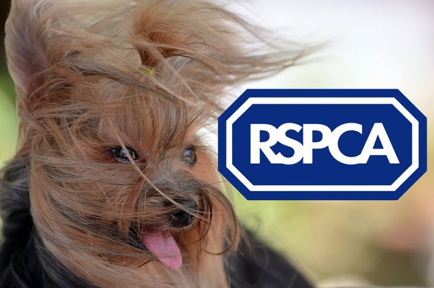
Ownership and Liability: Not for profit
For example, a charity such as the RSPCA is classified as a not-for-profit organisation, it is the oldest welfare charity and is mainly funded by donations and grants, with any surplus money being reinvested into the charity so the organisation can fund campaigns to “raise standards of care, and awareness of issues, affecting animals today”.
Alongside charities, voluntary organisations (set up and run by people solely on a voluntary basis e.g. MacMillan Cancer Support) and social enterprises (which aim to help society by selling products or services and utilising those profits to benefit select segments of society e.g. The National Trust) are both further examples of not-for-profit organisations.

Slide 23
Ownership and Liability
Activity 4: Start your own Not-for-profit Organisation.
Your task is to start your own not-for-profit organisation, it can be to support any cause you’d wish to support e.g. the RSPCA is a charity based around animal welfare and exists to “raise standards of care, and awareness of issues, affecting animals today”.
Once you have an idea, create a pitch (in any format you wish) which could be used to raise funds for your not-for-profit organisation (paste screenshots of the pitch in the box provided in your workbook), it should include the following:
The name of your not-for-profit organisation.
A logo and slogan.
An explanation of what cause your not-for-profit is set up to support and why.
The USP of your not-for-profit organisation.
Where you will operate (physical store or online etc.).
How you will raise money for your chosen cause.
The target market.
Short, medium and long term aims.
A justification of why you think it will be successful.

Slide 24
Purposes
Alongside the type of ownership, it’s also important to understand why businesses exist i.e. what is their purpose?
Every business exists for a purpose whether this be to supply products such as Currys PC World who sell electronical goods such as TVs and PCs or to provide a service such as a barber shop.
However, many businesses now offer a hybrid approach to maximise the value and experience they provide to their customers aswell as to boost their profit margins.

Slide 25
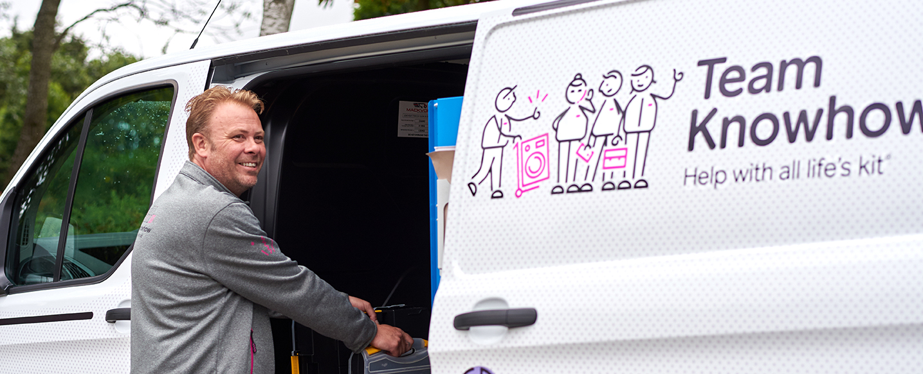
Purposes
Within this hybrid approach, businesses which predominately supply products offer services in addition.
For example, Currys PC World offer services to their customers which compliment the products they purchase such as the opportunity to have a PC set up or a cooker delivered and fitted through their ‘Knowhow’ team.

Slide 26
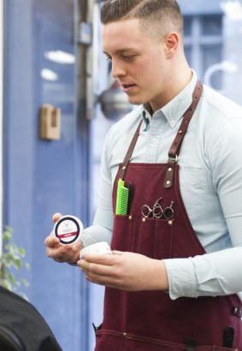
Purposes
In comparison, businesses which predominately provide services offer customers the opportunity to purchase products which complement the service.
For example, it’s common for a barber to offer customers hair care products to purchase such as gel and wax following a hair cut.

Slide 27
Sectors:
Businesses operate within sectors related to their nature and the products or services it provides.
Within business, there are four main sectors which outline the key stages that a product goes through, right from the initial sourcing of raw materials to the final product being ready for the customer.
Primary
Secondary
Tertiary
Quaternary

Slide 28
Sectors: Primary
The primary sector is essential and provides the foundations for the majority of businesses across all sectors and industries.
Businesses that operate within the primary sector extract and harvest natural products from the land to collate raw materials and natural resources which are then sold on to other businesses who manufacture products or provide services.
Common examples of the types of businesses in the primary sector include: fishing, farming, mining, and agriculture.

Slide 29
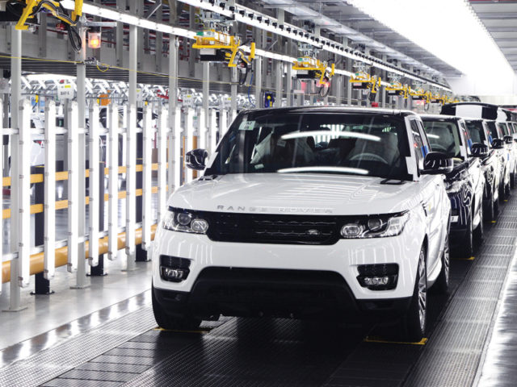
Sectors: Secondary
The secondary sector involves businesses who use the raw materials from the primary sector and turn them into products.
Essentially, businesses in the secondary sector are manufacturers such as those in the car industry e.g. Jaguar Land Rover, Audi, and Vauxhall.
However, any business which utilises raw materials and coverts them into new products through the manufacturing and assembly process would classify as operating within the secondary sector.
Alongside car manufacturers, other examples of businesses which operate in the secondary sector include food production businesses such as a fast food, electronics or clothes manufacturers.

Slide 30
Sectors: Tertiary
Businesses which operate within the tertiary sector provide services to other businesses or people.
On a B2B basis, these services typically support the production and distribution processes of other businesses such as advertising and marketing, transport, or healthcare etc.
Alternatively, services can also be provided on a predominately B2C basis, examples include cinemas, supermarkets and beauty salons.

Slide 31
Sectors: Quaternary
The quaternary sector is similar in nature to the tertiary sector as businesses in this sector also provide services.
Infact, 76% of the UK’s workforce is employed across the tertiary and quaternary sectors (BBC, 2021).
However, businesses which provide services in the quaternary sector typically provide information services such as consultancy, research and development, data collection, specialised financial services, or professional bloggers.
Notes:
BBC (2021): https://www.bbc.co.uk/bitesize/guides/zx3vtyc/revision/1

Slide 32
Sectors:
Activity 5: Sectors Explained.
In small teams, you are required to create a TikTok style video which explains the four different types of sectors in business that we have just discussed (Primary, Secondary, Tertiary, and Quaternary).
The TikTok style video should explain the key characteristics of each sector and provide examples of businesses which exist in each one.

Slide 33
Scope of Business Activities:
The owners of a business decide where they choose to sell their products and/or services, it can do this on either a local, national or international basis.
Activity 6a: before we investigate each option in more detail, provide an example of businesses which operate locally, nationally, and internationally?

Slide 34
Scope of Business Activities: Local
Business which operate on a local basis are based either in their own town, city or the vicinity of their geographical area.
Selling goods or products on a local basis is very common for sole trader businesses such as a hairdressers, newsagents, or a fruit and veg shop where the owner offers their products and/or services to the local community i.e. via a shop on the local high street.

Slide 35
Scope of Business Activities: Local
Local businesses can find it difficult to compete with larger nationwide and international businesses due to weaker buying power and smaller margins etc.
However, local businesses often have the key advantage of truly understanding the needs and wants of the local community and their service is tailored to the target market, rather than a generic and standardised offering which is found with most nationwide and national businesses.

Slide 36
Scope of Business Activities: Local
Activity 6b: Identify 3 businesses which operate in your local area only and answer the following questions for each one:
What is the core product or service that they sell?
How much competition have they got from other local businesses?
Why do you think this business only operates at a local level?

Slide 37
Scope of Business Activities: National
Business which are classified as operating on a national basis conduct trade within their own country.
Therefore, they are bigger than a local business and are likely to have multiple stores across the country and/or the ability to deliver to various locations across the country, but do not trade in any other countries across the world.
In a similar sense to businesses that operate on a local basis, businesses that operate on a national basis have the advantage of understanding the culture and trends of the nation which supports them to satisfy the needs and wants of their target audience more accurately in comparison to a competitor who operates on a global basis.
Because national businesses often have more locations and more customers, they also have greater buying power than local businesses which then typically allows them to be more competitive with the pricing of their products and services.

Slide 38
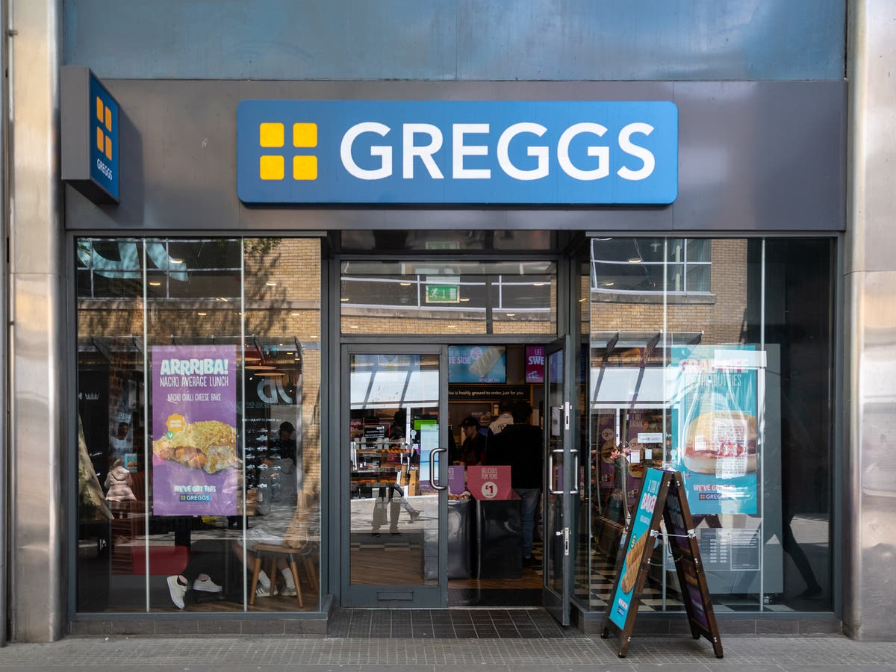
Scope of Business Activities: National
Greggs bakery is a perfect example of a national business which started locally. “Eighty years ago, John Gregg started out with one goal, to deliver (by pushbike) fresh eggs and yeast to the families of Newcastle, today they have over 1,950 stores nationwide.
Over the years, Greggs opened more shops across the country and looked for ways they could make the business even better. Their menu changed with the nation’s taste - who’d have thought of freshly ground Fairtrade Espresso from Greggs, they also added calories to their menu (before they had to) and provided free Wi-Fi – that’s been voted the best on the high-street.” (Greggs, 2021)
The above statement taken form Greggs site is a great example of a business which has been able to grow by understanding the wants and needs of its target audience, by adapting their menu over time to the nations taste and adding in demand features such as calories to their menu and Wi-Fi in their stores.
Notes:
https://corporate.greggs.co.uk/at-a-glance/our-history

Slide 39
Scope of Business Activities: National
As Greggs has grown as a business and added more locations etc. it has increased its buying power, so when it buys raw materials such as the ingredients to make its pastry products, it is able to do so in greater quantities and therefore for a reduced amount per unit. This enables Greggs to offer a competitive price to its customers whilst achieving respectable profit margins.
Infact, in 2019 Greggs made record profits, in the same year that it launched its vegan snack range, another indication of strong margins but also the bakery chain listening to the wants and needs of the nation and a growing market in the UK.
Notes:
https://corporate.greggs.co.uk/at-a-glance/our-history

Slide 40
Scope of Business Activities: National
Activity 7: Trading Nationwide and Expanding Internationally
Pick just one of the local businesses you identified in the previous task and write a letter to the owner to convince them to expand the business and trade on a national basis. Ensure you justify how this could be achieved with supporting examples and why you think this would be good strategic move for the business, alongside analysis of the potential drawbacks for the business.
Could Greggs go international? Scenario: you are a business consultant and the owners of Greggs are considering expanding the business and opening stores in the USA. Analyse the benefits and drawbacks of the bakery chain expanding internationally. Then conclude with a justified recommendation for the business to either remain in the UK only or expand into the USA.
Notes:
https://corporate.greggs.co.uk/at-a-glance/our-history

Slide 41
Scope of Business Activities: International
Businesses which are classified as operating on an international basis, essentially operate in more than one country.
McDonald’s, Subway, and Starbucks are famous examples of businesses which have expanded their operations over the years to trade internationally.
They have grown their operations from being national businesses to one where they have 1000s of stores across 100s of countries in the world.
Whilst trading internationally is great for brand awareness, an increased customer base, and sales revenue etc. operating internationally can be very complex.

Slide 42
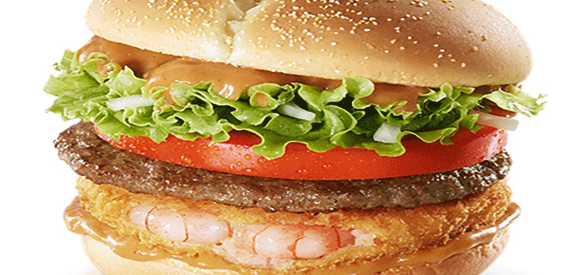
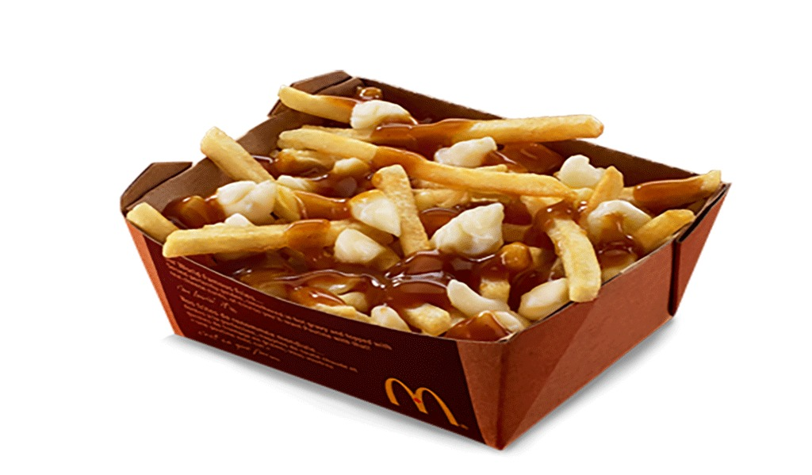
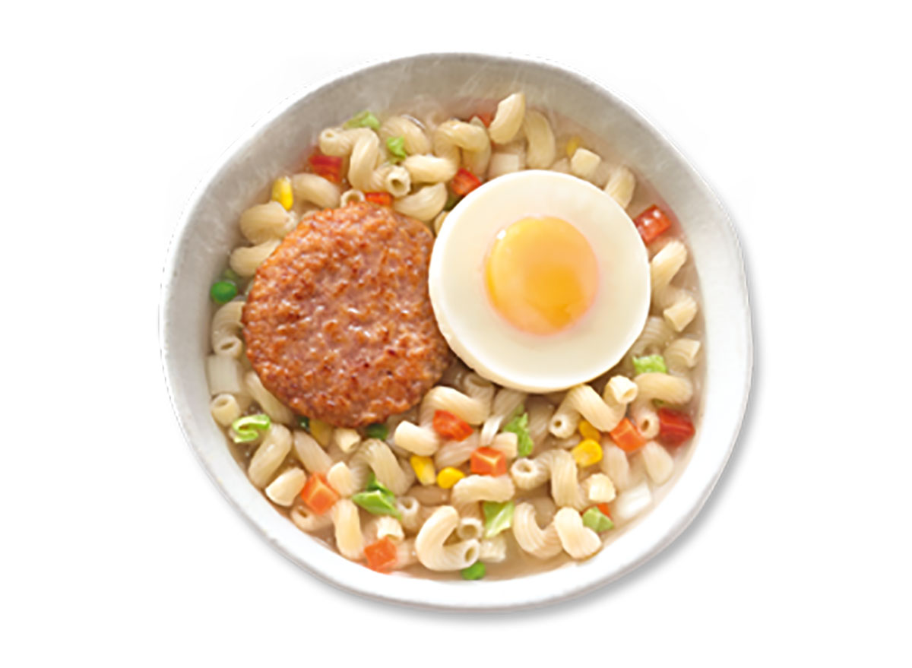
Scope of Business Activities: International
When a business such as McDonald’s opens a store in another country outside of the USA, it has to make significant changes in its marketing mix to adapt to the countries' culture and the wants and needs of its residents.
For example:
In Canada, McDonald’s serves ‘French Fries in Gravy and Cheese Curds’ (known as Poutine) which is a Canadian staple.
In Korea, McDonald’s serves a ‘Shrimp and Beef Burger’ to satisfy the wants and needs of Korea’s McDonald’s customers.
In China, McDonald's serves ‘Ham N' Egg Twisty Pasta’ on its breakfast menu, which is quite different to the ‘Bacon Roll’ served in the UK.
However, it’s not just cultural differences which a business must consider when operating internationally, the law is often different in every country.
Therefore, it’s crucially important that the business is clearly aware of these rules and regulations when it expands into a new country.

Slide 43
Scope of Business Activities: International
Activity 8: watch the video on the next slide (Why Starbucks Failed in Australia) and complete the following tasks:
What did Starbucks do wrong when they opened stores in Australia and what were the key factors which led to them closing 61 Australian stores in 2008?
Why have Gloria Jean’s Coffee Shops been so successful in Australia when Starbucks failed?
Do you think targeting tourists in Australia is a good strategy for Starbucks?
Australia has one of the biggest and most competitive coffee shop markets in the world. Your task is to design a coffee shop brand which you believe would be able to compete in this competitive market. Ensure you include the following factors as a minimum:
The name of your coffee shop
A logo and slogan
The USP of your coffee shop
The range of products you would sell
The target market
The experience customers would get in store

Slide 44
Scope of Business Activities: International
Video link: Why Starbucks Failed in Australia
Notes:
https://www.youtube.com/watch?v=_FGUkxn5kZQ

